Slide 1
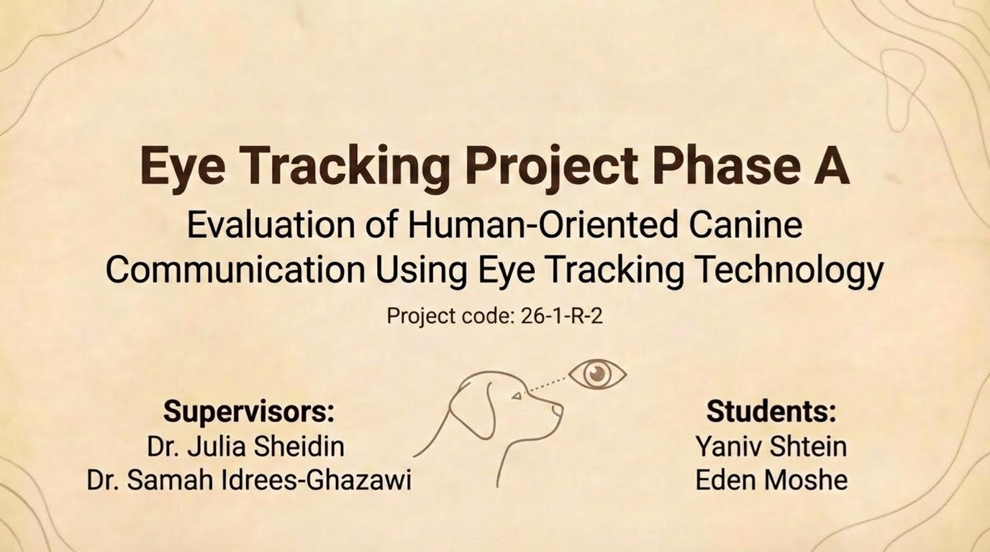

1
Notes:
Hello, my name is Eden and this is my partner Yaniv, and today we will introduce to you our phase A.
The project is titled “Evaluation of Human-Oriented Canine Communication Using Eye Tracking Technology” which is a very long title but in short it means that we are not trying to understand what the dog feels, we are trying to understand how humans look at dogs, and which visual cues help them interpret the dog’s behavior and emotional state.
In this presentation, we will introduce the motivation behind the project, the research background, and mainly the methodology we designed in Phase A. also important to mention: the project is supervised by Dr. Julia Sheidin and Dr. Samah Idrees-Ghazawi.

Slide 2
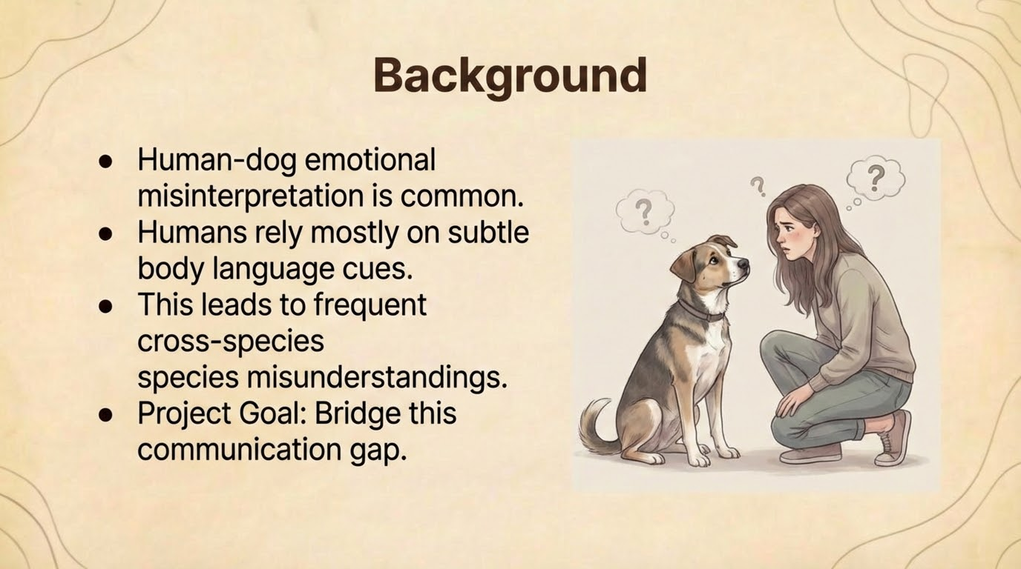
2
Notes:
To start with some background, misinterpretation between humans and dogs is actually very common. People usually rely on small body language cues, like facial expressions, posture, or small movements but these cues are often misunderstood. Because of that, we see many cross-species misunderstandings, where humans think they understand the dog, but interpret the situation incorrectly. The goal of our project is to help bridge this communication gap, by better understanding how humans visually interpret dogs.

Slide 3
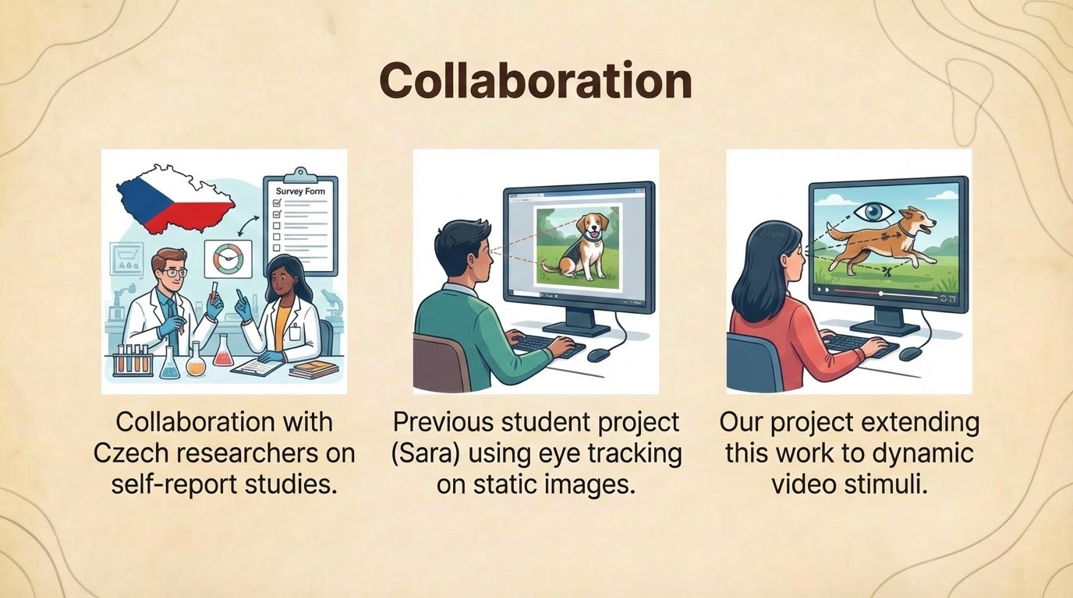
3
Notes:
This project builds on existing academic work and is part of an ongoing collaboration with Czech researchers who studied human - dog communication mainly through self-report questionnaires. In addition, a previous student project introduced the use of eye-tracking technology, but focused only on static images. While these studies provided important insights, they are limited in their ability to capture the dynamic nature of dog behavior. Our project extends this work by using dynamic video stimuli combined with eye tracking, allowing us to observe how human gaze evolves over time and how visual attention shifts across different areas of the dog’s face and body in more realistic scenarios.

Slide 4
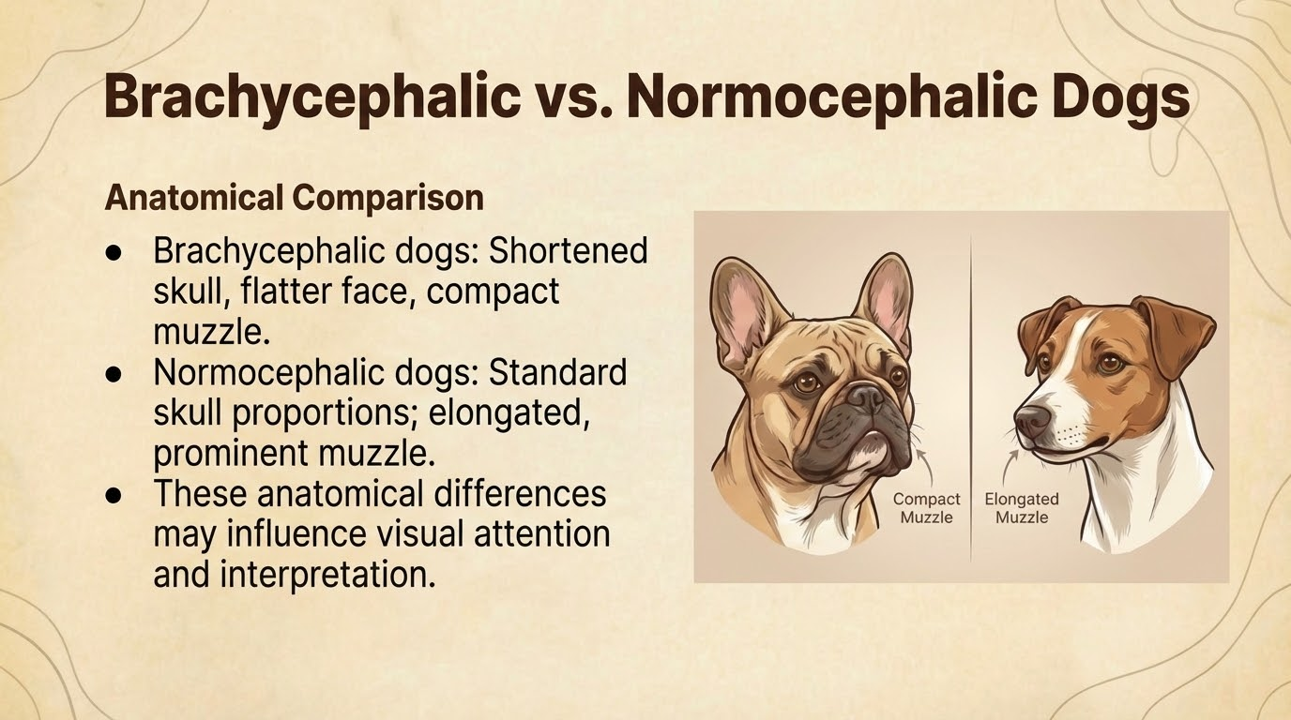
4
Notes:
In this project, we deliberately focus on two specific dog groups: brachycephalic and normocephalic dogs. This division creates a clear and balanced comparison, as these two types represent opposite ends of canine skull features and effectively split dog facial structures into two central categories. Brachycephalic dogs are characterized by a shortened skull, a flatter face, and a compact muzzle, while normocephalic dogs have more standard skull proportions with an elongated and more prominent muzzle. By working with these two groups, we are able to examine how distinct anatomical features influence human visual attention and interpretation, making this comparison a core element of our research design. It is important to note that both the Czech researchers and the previous student project used the same division, allowing our work to stay consistent with earlier research.

Slide 5
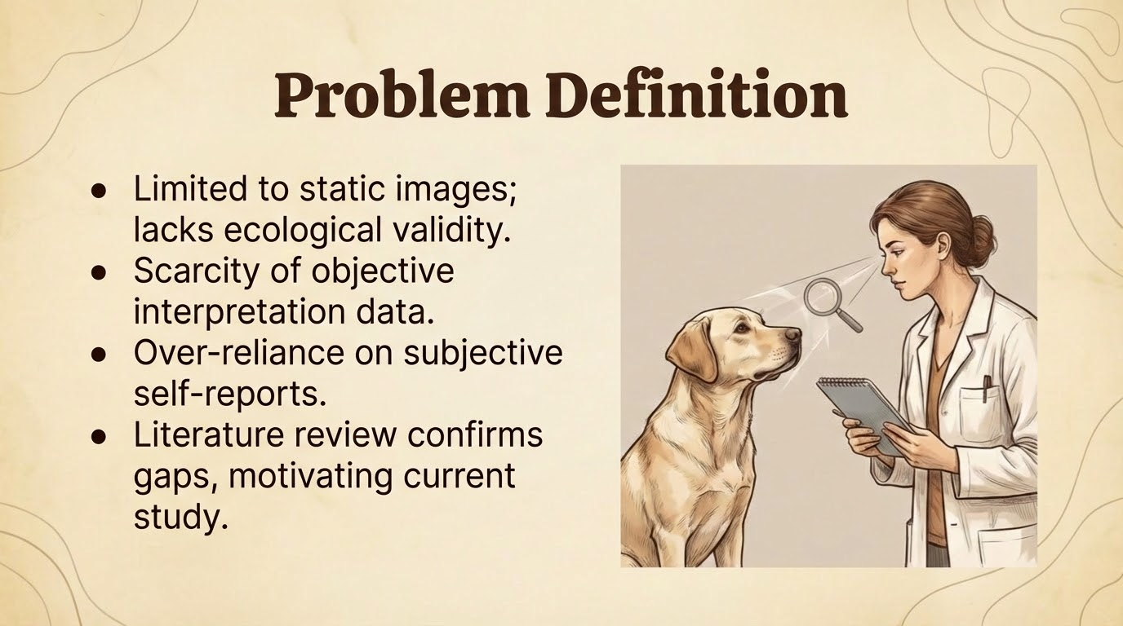
5
Notes:
The main problem identified in existing research is that many studies rely heavily on static images, which limits ecological validity and fails to capture the dynamic and temporal nature of dog behavior. In addition, much of the interpretation is based on subjective self-reports, where participants describe what they believe they observed, rather than what they actually focused on visually. This creates a gap between perceived attention and real visual behavior. For example, several studies in the literature examine emotion recognition using still photographs or questionnaires, which provide valuable insights but lack objective, time-based measures of gaze. Our literature review consistently points to this limitation and highlights the need for more objective and dynamic methods, which directly motivates the design of the current study.
For example, studies such as Eretová et al. (2024) focused on human interpretation of dog emotions using static images, which allowed controlled comparison but did not capture the dynamic nature of canine behavior. Other works in the literature also relied mainly on questionnaires and self-reports, without objective measurements of visual attention. These limitations are repeatedly highlighted in the literature review and point to the need for more dynamic and objective methods, such as eye tracking with video stimuli.

Slide 6
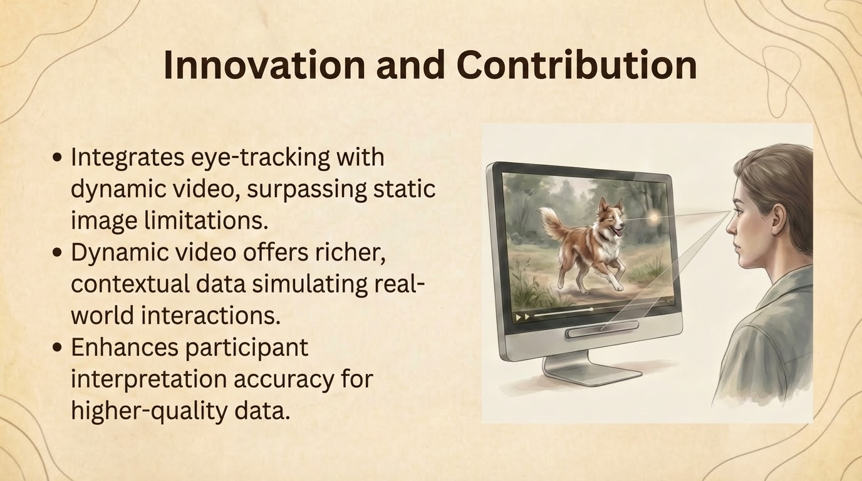
6
Notes:
The main innovation of this project lies in combining eye-tracking technology with dynamic video stimuli, rather than relying on static images as done in much of the existing research. By using videos, we are able to capture richer and more contextual information that better reflects real-world human-dog interactions. This approach allows us to observe how visual attention changes over time and how participants naturally shift their gaze between different areas of the dog’s face and body. As a result, the data collected is more realistic and informative, which can improve the accuracy of participants’ interpretations and lead to higher-quality, more objective insights.

Slide 7
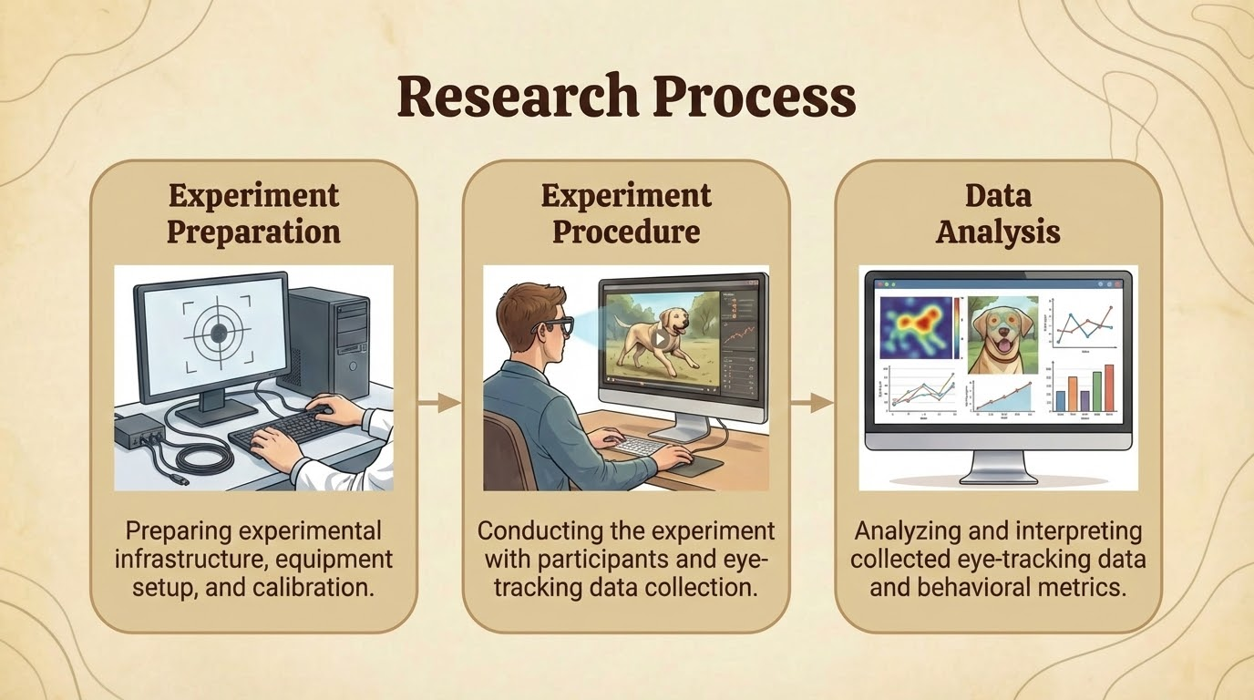
7
Notes:
This slide presents a high-level overview of our research process. We divided the study into three main stages: experiment preparation, experiment procedure, and data analysis. Each of these stages will be presented in more detail in the following slides. The purpose here is to give a clear structure of how the study is organized, from setting up the experimental environment and calibration, through conducting the experiment with participants, and finally analyzing and interpreting the collected eye-tracking and behavioral data.

Slide 8
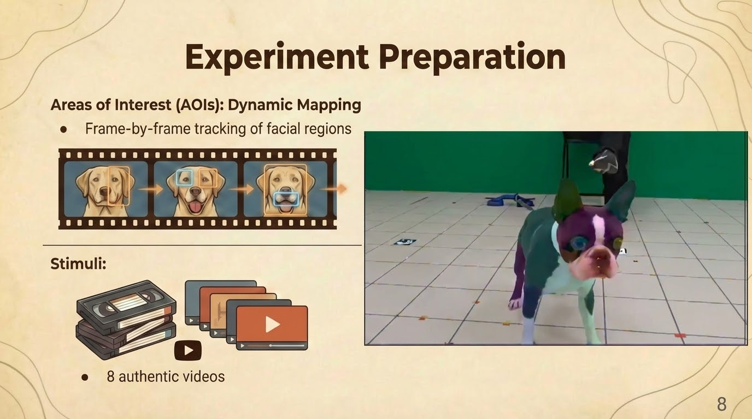
Notes:
Focused on preparing the experimental stimuli Defined Areas of Interest (AOIs) on the dog’s face and body AOIs were mapped dynamically, frame by frame Stimuli included 8 videos of dogs showing natural behavior Total of approximately 2,000 frames Right side shows an example frame illustrating the dynamic stimuli
say the aois of like snout, eyes, ears, legs, forehead, tail also mention how we separated eyes legs and cheeks from right to left
say that each video was 30 frames per second
eden did a good job. it took us a while to understand how to work with the tobii pro lab and what is the most efficient way to do it. we split the work half half, i did the normocephalic and she did the brachycephalic
the normocephalic dog that i did was a bit harder to do because he had more fur and his edges were harder to see, and he also moved alot more so it was difficult to work on those videos.

Slide 9
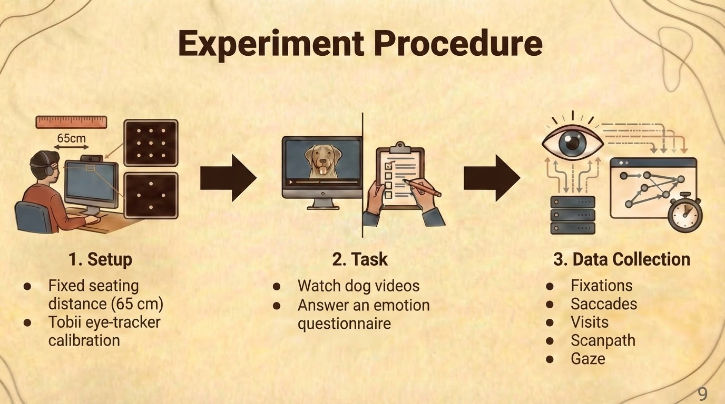
Notes:
After preparing the stimuli, we moved on to the experimental procedure
Participants were seated at a fixed distance of 65 cm from the screen
The Tobii eye-tracker was calibrated to ensure accurate gaze recording
Participants watched dog videos
After each video, they completed a short questionnaire about the dog’s emotional state
Once the task was completed, eye-tracking data was collected
Collected data included fixations, saccades, visits, scanpaths, and gaze
***in the setup we did experiments on our own and checked that the distance is good and the other parameters are good and also what position of the eyes are in reference to the screen.
in the task all the questions are the same for each video. the questions are what are the perceived emotional state of the dog, and about what parts did the participant look in the video, so that we will be able to compare between what they thought they looked at and what they actually looked at.
from the experiments we have already done we have seen most people look at the face but they report that they look at the body and other parts.

Slide 10
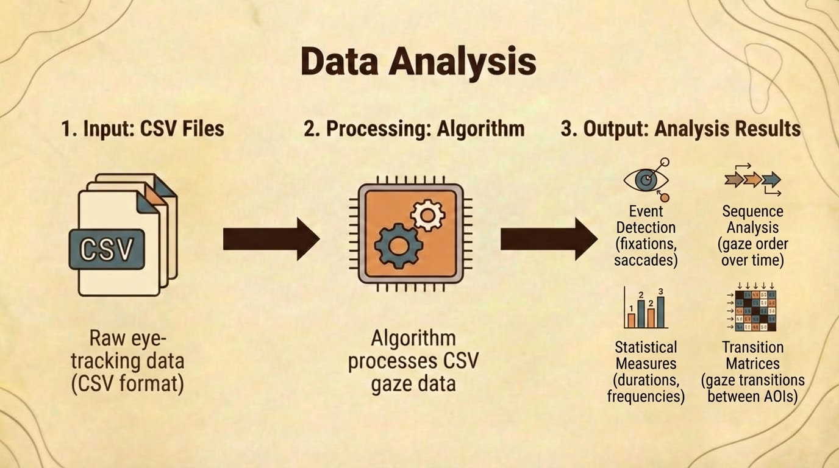
10
Notes:
so the data analysis is going to be done in phase 2 of the project
At this stage, we focus on data analysis.
The input to the analysis is raw eye-tracking data exported as CSV files.
These CSV files contain the participants’ gaze information over time.
Next, the data is passed through an algorithm that processes the gaze data.
The algorithm organizes the raw data into meaningful structures.
From this processing, we obtain several analysis outputs:
Event detection, identifying fixations and saccades
Sequence analysis, showing the order of gaze over time
Statistical measures, such as durations and frequencies
Transition matrices, describing gaze transitions between areas of interest
Together, these outputs allow us to move from raw gaze data to structured insights about visual attention behavior.

Slide 11
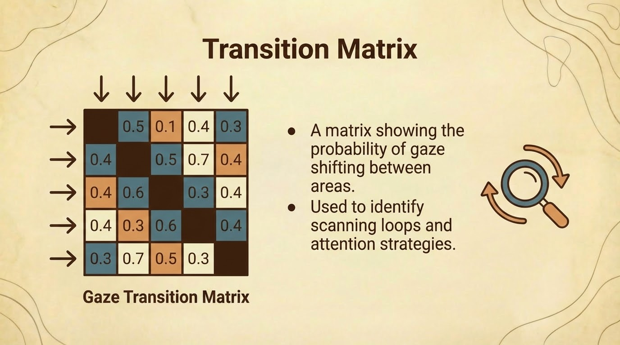
11
Notes:
so a little bit about the transition matrix
and now i will talk more in depth about the transition matrix
Each cell represents the probability of gaze shifting from one area of interest to another
Analyzing these transitions reveals attention patterns, such as scanning loops and dominant viewing strategies
This allows us to move from raw gaze data to a structured, quantitative representation of visual behavior
we will use the transition matrix saccades fixations etc and then we can understand from it different things

Slide 12
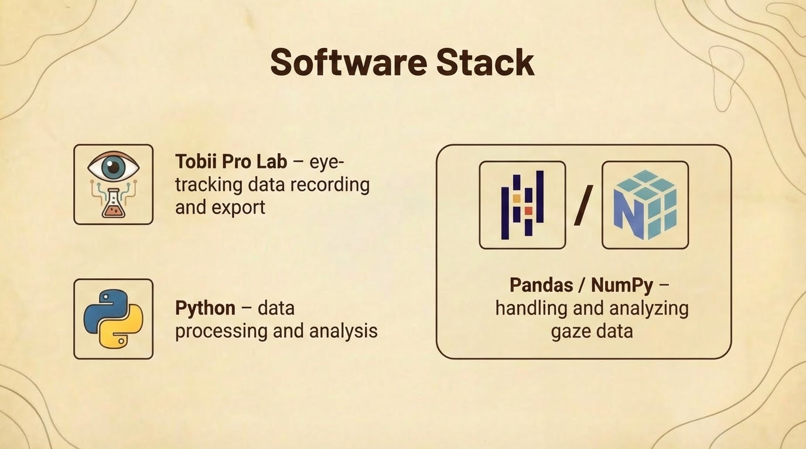
12
Notes:
This slide summarizes the software tools used in the project.
Tobii Pro Lab was used to record eye-tracking data and export the raw gaze measurements.
Python was then used for data processing, with Pandas and NumPy handling the analysis of the gaze data and preparing it for further modeling.
Together, this stack enabled an efficient pipeline from data collection to structured analysis.

Slide 13
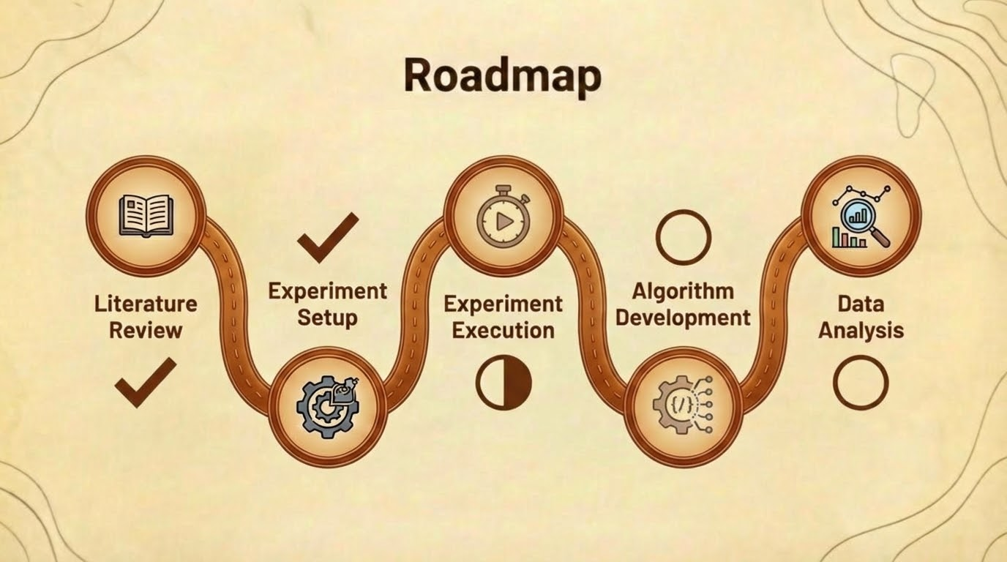
13
Notes:
this is the project roadmap. so in the beginning we read different studies about human-dog interactions. later we mapped aois and set up the experiment. now we are in the process of running the experiment. and for the next phase we will develop a algorithm that will process the data and then we will analyze the results to come up with conclusions.
wadie and noor we are waiting for you
say we already did 23 people in the experiment

Slide 14
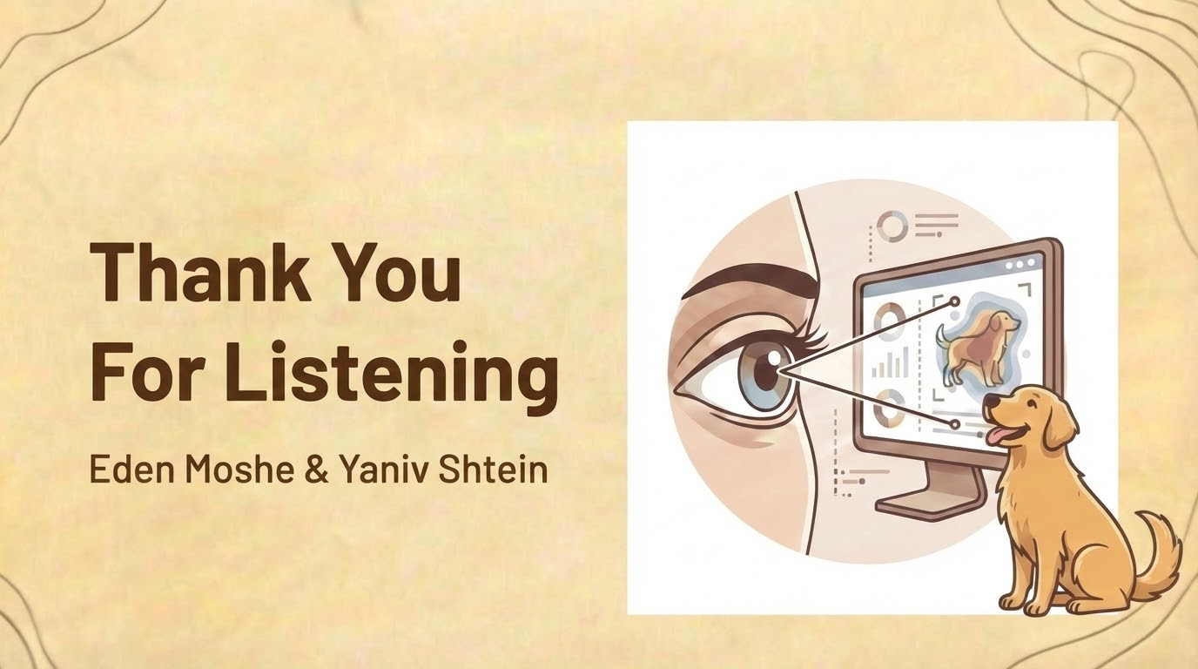
14
Notes:
thank you for listening, any questions?

